Slide 1
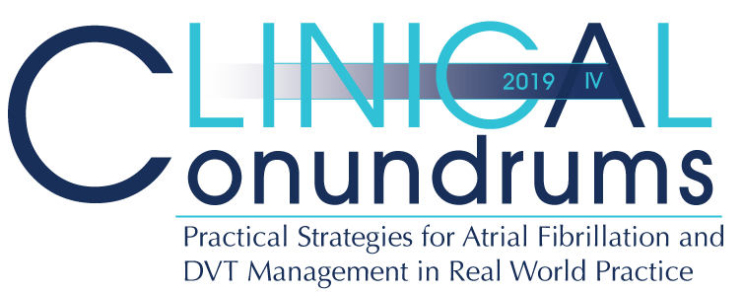



Case 9
CASE 5
Jean Bella
Optimizing The Use and Dosing of DOACs in Patients with AF

Slide 2

Learning Objectives
Upon completion of this activity, participants should be able to:
I
Apply the rationale for the appropriate use and non-use of community-based observational data (real-world data) in clinical practice.
II
Discuss real-world treatment patterns with OAC therapy
III
Effectively manage the use and dosing of OAC therapy in patients with AF

Slide 3
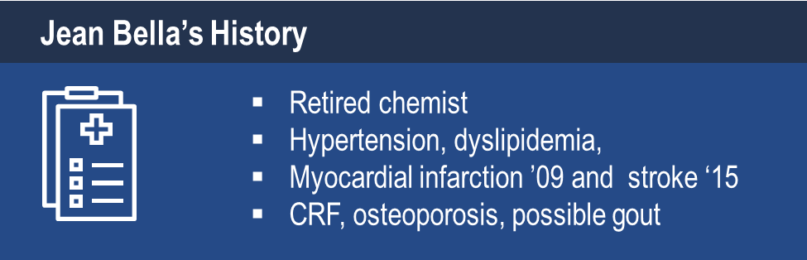
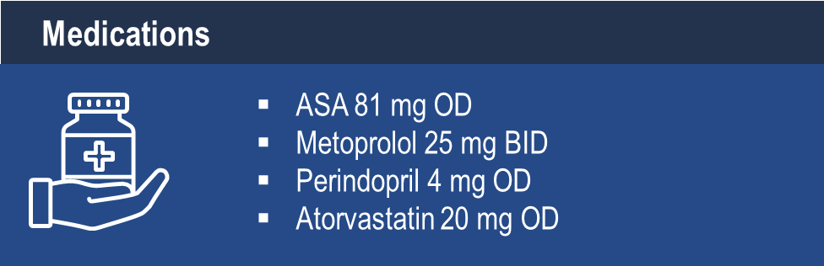
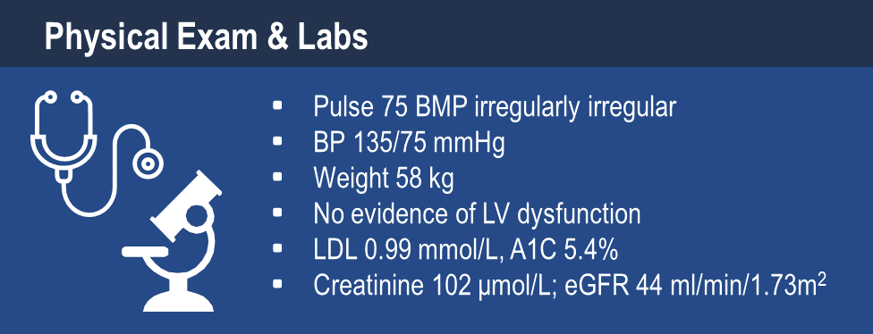
Case 9
Jean Bella
84 years old
Notes:
Speaker Notes:

Slide 4

Case 9
Jean Bella
84 years old
Jean Bella comes in for a routine visit.
She feels generally well but complains of an occasional “skipped heartbeat”.
BP 135/75, Pulse 75 bpm - irregularly irregular
Notes:
Speaker Notes:

Slide 5
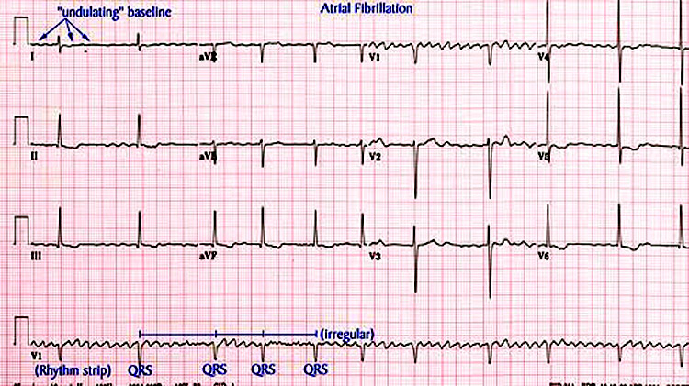
Case 9
Jean Bella
84 years old
Jean Bella’s ECG
Notes:
Speaker Notes:
The ventricular response rate to this atrial fibrillation is auto-controlled. In the absence of therapy to accomplish this goal the finding of auto-controlled atrial fibrillation implies AV conduction system disease (usually AV nodal) and predicts the ultimate requirement for a pacemaker.

Slide 6

An Approach to the Patient with Newly Diagnosed (“de novo”) Atrial Fibrillation
01
Assess urgency (symptomatic state, vitals, examination)
02
Must assess / control the ventricular response rate
03
Ask why and why now?
(electrolytes / creatinine / TSH, echocardiogram)
04
May consider establishing / maintaining sinus rhythm
05
Must consider stroke risk and stroke prevention
Notes:
Speaker Notes:

Slide 7

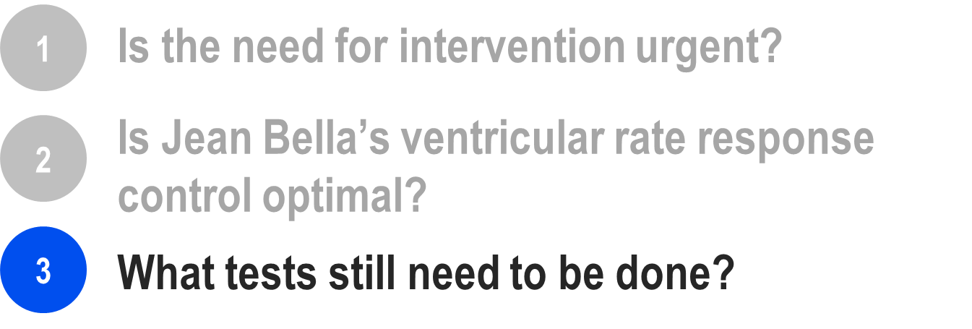

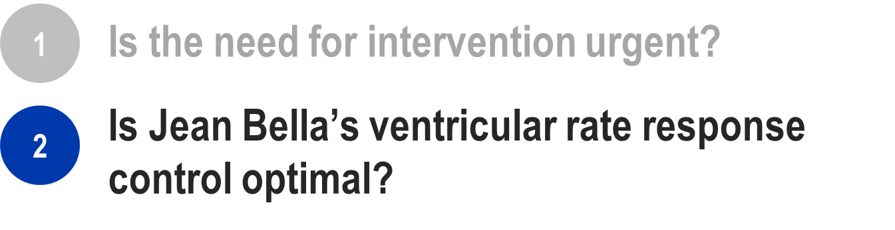
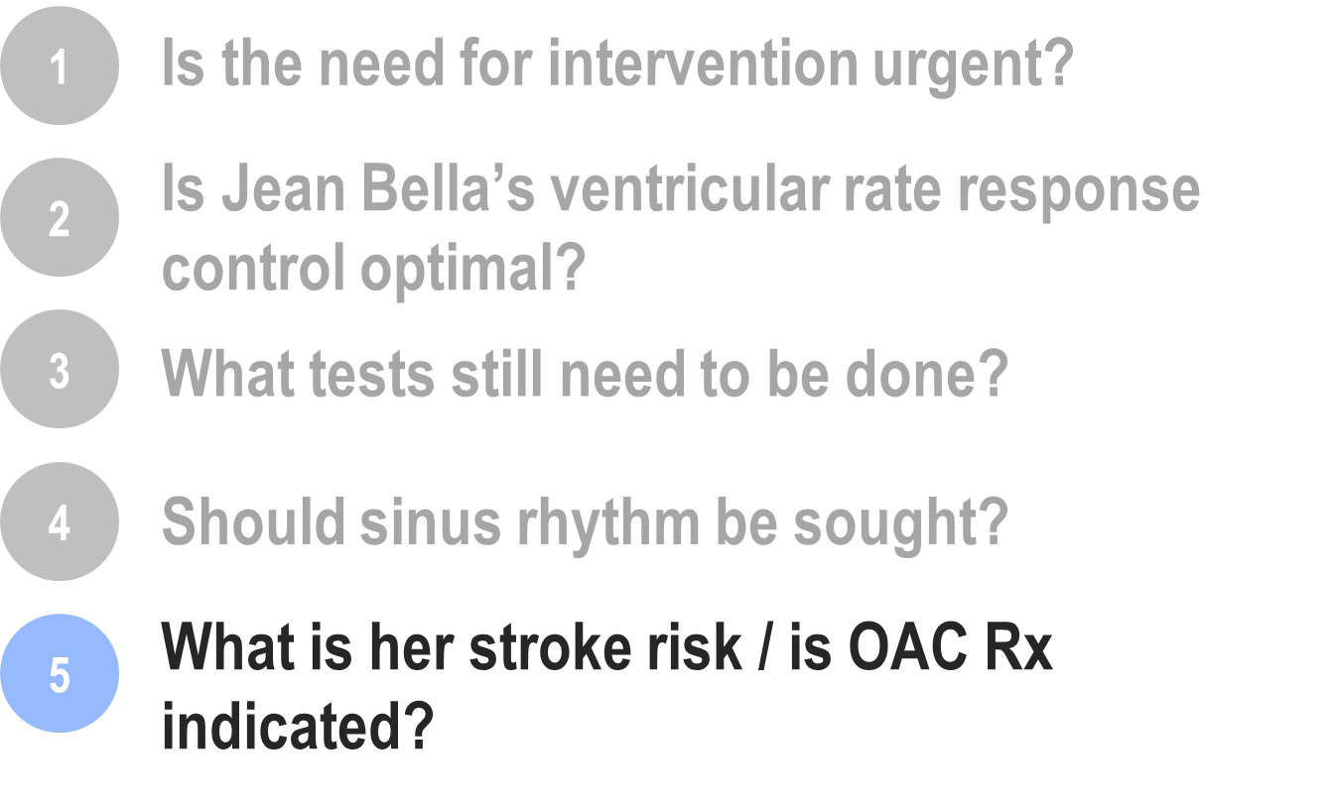
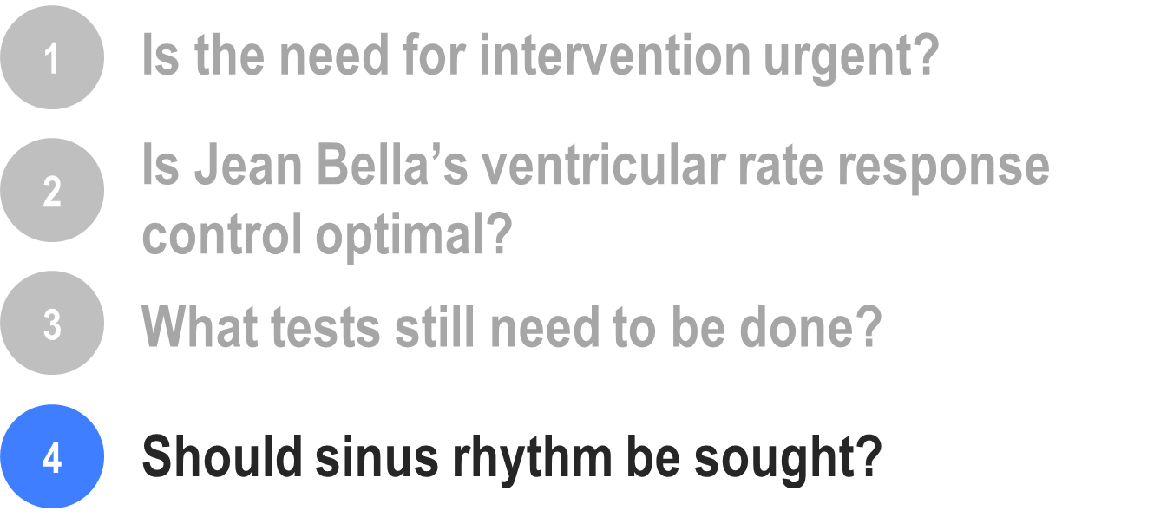
What would you do now?
Notes:
Speaker Notes:
In patients in whom AF is suspected based on symptoms or history of CVA or TIA, a longer term ECG monitoring such as Holter monitoring or event loop recording is recommended longer is better

Slide 8
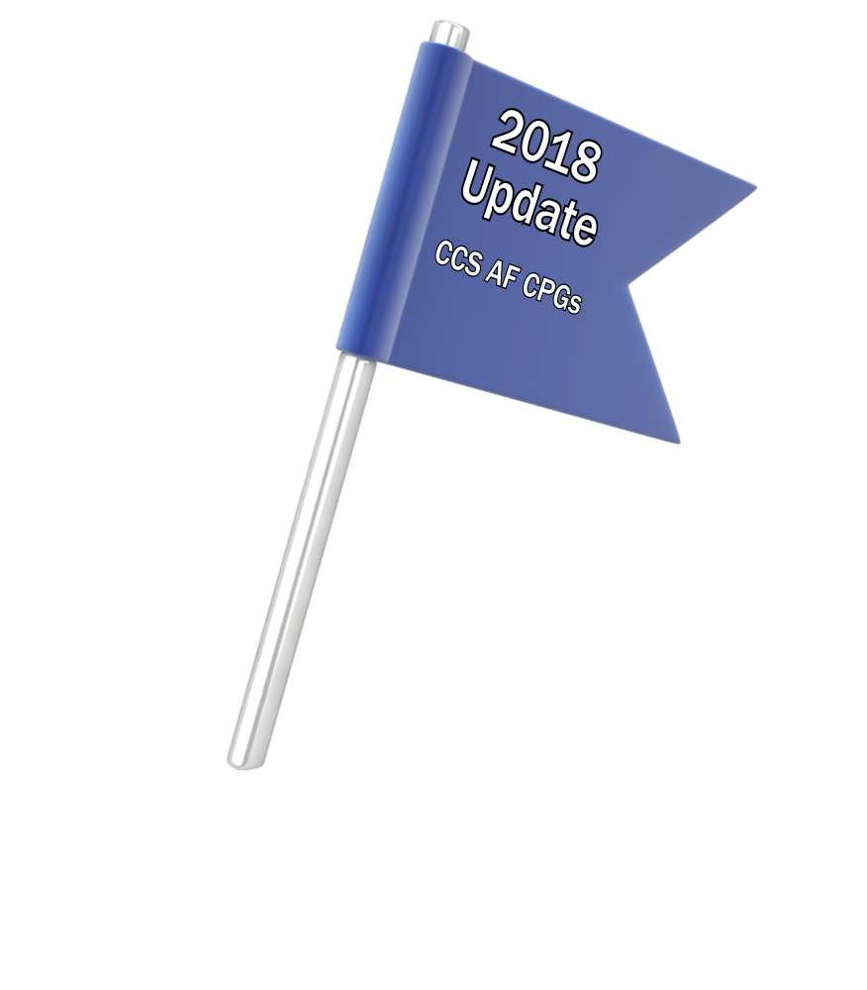
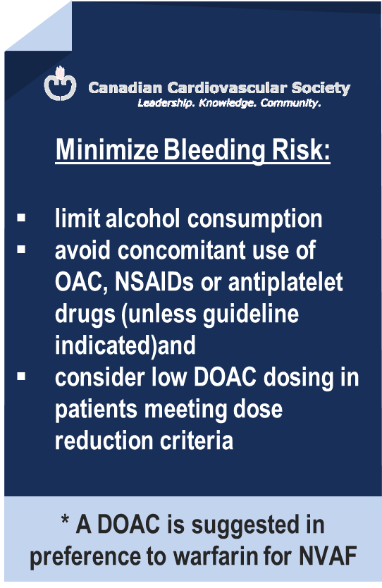
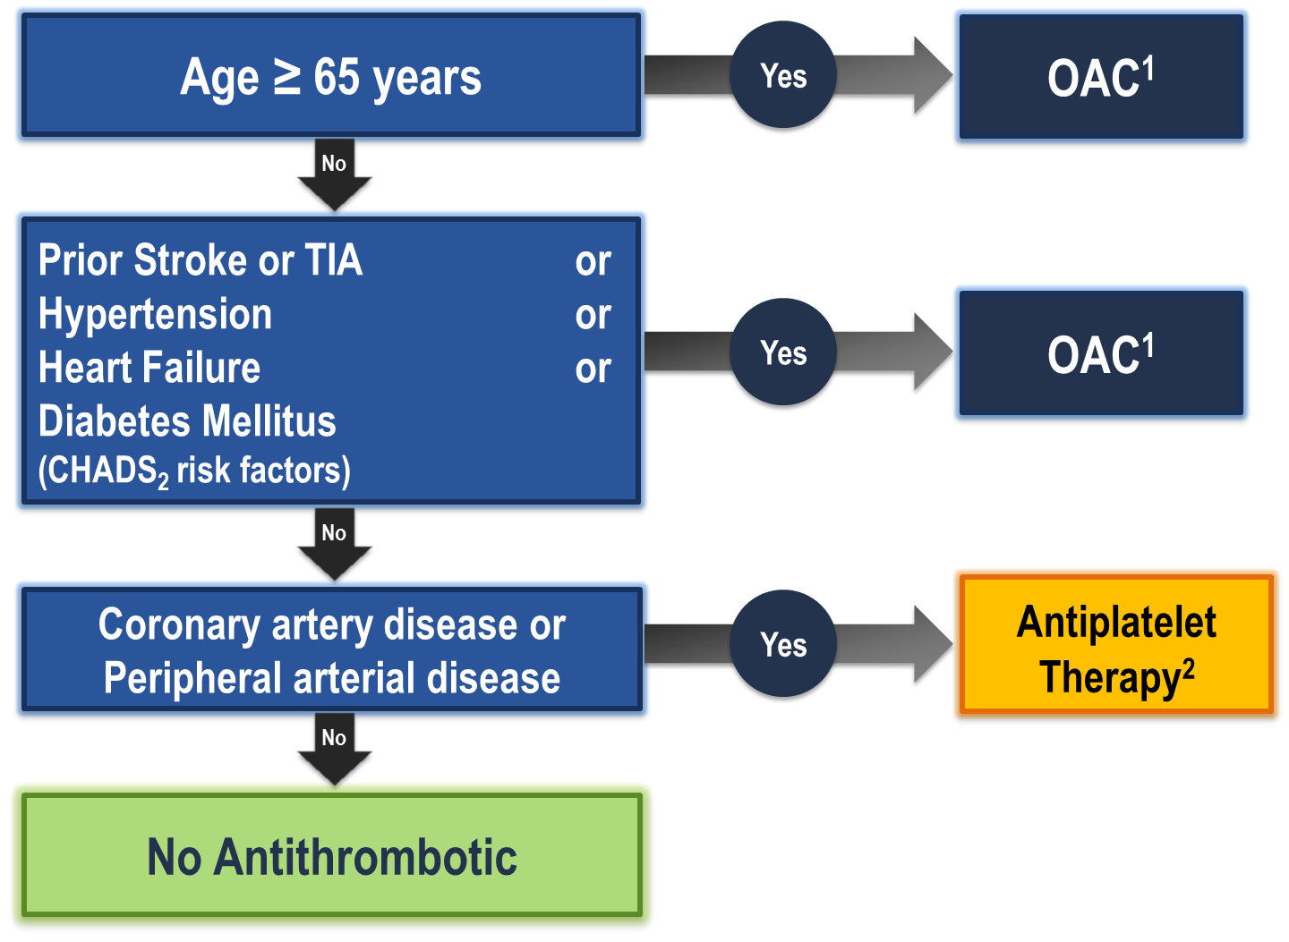
The “CCS Algorithm” (CHADS-65) for OAC Therapy in AF
¹ A NOAC is preferred over warfarin in non-valvular AF
² Therapeutic options include single antiplatelet therapy (ASA 81-100 mg daily) alone; or in combination with either a second antiplatelet agent (e.g. clopidogrel 75 mg daily or ticagrelor 60 mg BID), or an antithrombotic agent (rivaroxaban 2.5 mg BID)
Andrade JG et al. Can J Cardiol 2018;34:1371-1392
CCS AF Guidelines. Can J Cardiol. 2016; 32: 1170-1185
Notes:
Speaker Notes:
This is the new and important slide from the 2018 (box to the right is from the 2016 update) Canadian AF guidelines update.
Two key points to emphasize: the (*) indicates that a DOAC should be selected in preference to an AVK for anticoagulation. The shaded box to the right emphasizes that all efforts should be made to select the correct DOAC dosage based on age, size and renal function as well as to minimize the bleeding risk by addressing any modifiable bleeding risk factors present.
There is no longer any need to calculate a patient’s HASBLED score as this does not influence management (most patients are antioagulated even, if at higher bleeding risk..)
Canada has not adopted the CHADSVASC scoring system to determine eligibility for oral anticoagulation in AF. The annual embolic stroke risk threshold for anticoagulation is set at 1.5% and it is felt that a vascular diseased patient who is aged 64 or less and CHADS2 = 0 has an annual stroke risk of less than 1.5% based on the Canadian Guideline Committee’s interpretation of currently available large data sets.

Slide 9
DOACs as Compared to Warfarin Indirect Comparisons from the Clinical Trials
 | Apixaban¹ ^{(eliquis)} | Dabigatran 110² ^{(Pradaxa)} | Dabigatran 150² ^{(Pradaxa)} | EDOXABAN 60 ^{(lixiana)} | Rivaroxaban³ ^{(Xarelto)}
Stroke/SE
Major Bleed
Intracranial Bleed
GI Bleed
All Cause Death
To date there are no head-to-head trials between apixaban, dabigatran, edoxaban and rivaroxaban, therefore comparative efficacy and safety have not been established
Significant Increase
Significant Reduction
Non Significant Difference
Granger et al., NEJM 2011; 365: 981-992
Connolly et al., NEJM 2009; 361: 1139-1151
Patel et al., NEJM 2011; 365: 884-891
Giuliano RP et al NEJM 2013; 369:2091
Notes:
Speaker Notes:
This slide shows some key efficacy and safety outcome data vs. warfarin from the four major DOAC trials: RE-LY, ROCKET, ARISTOTLE and ENGAGE
Apixaban and Dabigatran 150 mg were associated with significant reduction of stroke/SE vs. warfarin.
Apixaban, Dabigatran 110 mg and Edoxaban were associated with significant reduction of major bleeding vs. warfarin.
All DOACs were associated with a significant reduction of intracranial bleeding (ICH) compared to warfarin.
Dabigatran 150 mg, Edoxaban and Rivaroxaban were associated with an increase in GI bleeding vs. warfarin.
Apixaban is associated with a significant reduction in mortality compared to warfarin.
Definition of major bleeding:
RE-LY: a reduction in the hemoglobin level of at least 20 g per liter, transfusion of at least 2 units of blood, or symptomatic bleeding in a critical area or organ.
ROCKET: as clinically overt bleeding associated with any of the following: fatal outcome, involving a critical site (i.e., intracranial, intraspinal, intraocular, pericardial, intraarticular, intramuscular with compartment syndrome, or retroperitoneal), or clinically overt bleeding associated with a fall in hemoglobin concentration of ≥ 2 g/dL, or leading to transfusion of ≥ 2 units of packed red blood cells or whole blood.
ARISTOTLE: clinically overt bleeding accompanied by a decrease in the hemoglobin level of at least 2 g per deciliter or transfusion of at least 2 units of packed red cells, occurring at a critical site, or resulting in death.
ENGAGE: International Society of Thrombosis and Hemostasis definition : clinically overt bleeding accompanied by a decrease in the hemoglobin level of at least 2 g per deciliter or transfusion of at least 2 units of packed red cells, occurring at a critical site, or resulting in death.
References:
﻿Connolly SJ, et al; for the RE-LY Steering Committee and Investigators. Dabigatran versus warfarin in patients with atrial fibrillation. N Engl J Med 2009; 361:1139-1151.
Connolly SJ, et al; for the RE-LY Investigators. Newly identified events in the RE-LY trial. N Engl J Med 2010; 363(19):1875-1876.
Patel MR, et al; and the ROCKET AF Steering Committee for the ROCKET AF Investigators. Rivaroxaban versus warfarin in nonvalvular atrial fibrillation. N Engl J Med 2011; 365:884-891.
Granger CB, et al; for the ARISTOTLE Committees and Investigators. Apixaban versus warfarin in patients with atrial fibrillation. N Engl J Med 2011; 365:981-992.

Slide 10
Case 9
You decide to prescribe a DOAC to
Jean Bella
Notes:
Speaker Notes:

Slide 11

Which DOAC would you prescribe to
Jean Bella?
Select from one or more of the available options
Apixaban 5 mg BID
Apixaban 2.5 mg BID
Dabigatran 150 mg BID
Dabigatran 110 mg BID
Edoxaban 60 mg OD
Edoxaban 30 mg OD
Rivaroxaban 20 mg OD
Rivaroxaban 15 mg OD
Notes:
Speaker Notes:

Slide 12
Is a DOAC dose adjustment required for Jean Bella?
Select from one the available options
Yes
No
Depends on the DOAC prescribed
Notes:
Speaker Notes:

Slide 13
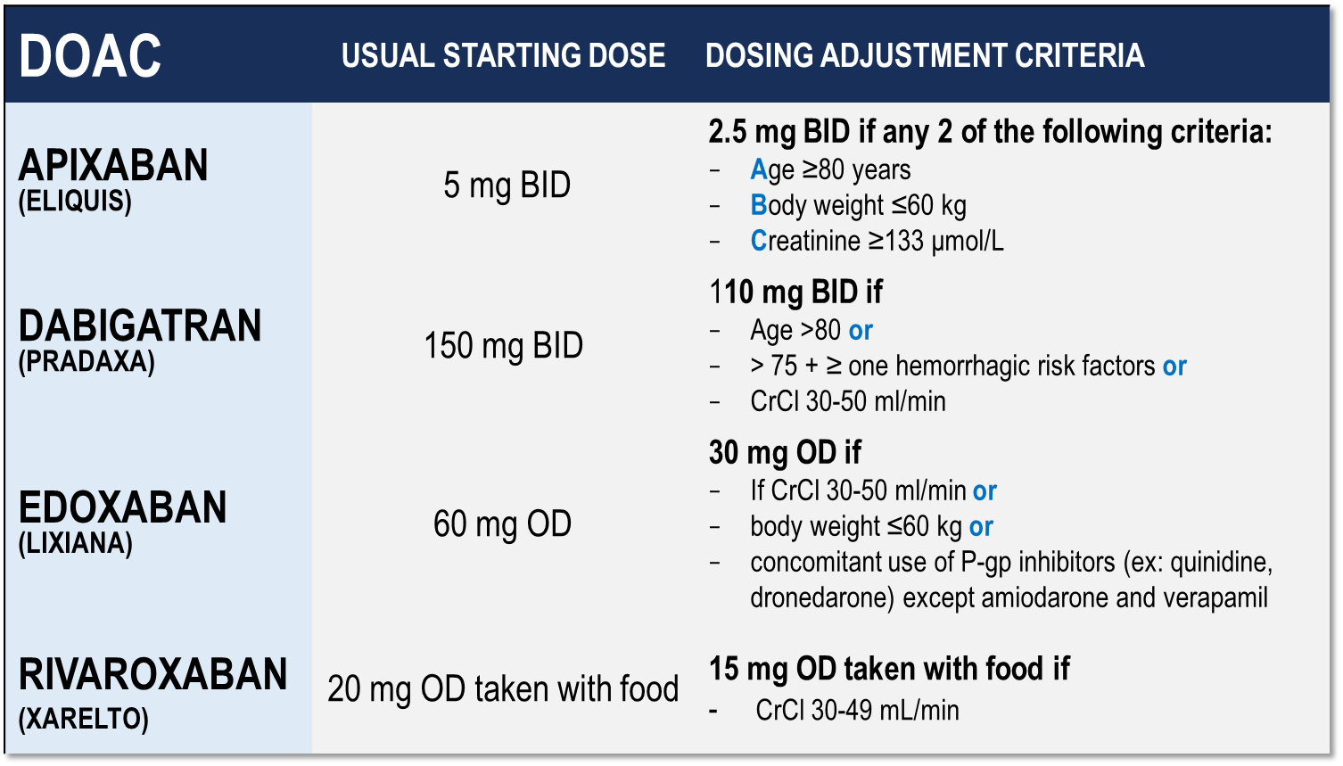
Considerations for Dosing of DOACs
Pfizer Canada Inc./BMS Canada. Eliquis (apixaban) Product Monograph, 2018.
Boehringer Ingelheim Canada Ltd. Pradaxa (dagbatran) Product Monograph. August 11, 2016.
Bayer Inc. Xarelto (rivaroxaban) Product Monograph. 2018.
Daiichi Sankyp Inc. Lixiana (edoxaban) Product Monograph. 2017.
Notes:
Speaker Notes:
Indispensable slide summarizing the criteria for a dosage adjustment from the default higher dosage for the different DOACs currently available in Canada
The dosing adjustments proposed for apixaban, edoxaban and rivaroxaban are those utilized to the dosage of selected patients enrolled in the respective prospective clinical trials (ARISTOTLE, ENGAGE and ROCKET-AF). The overall goal was to achieve a stable plasma concentration in subjects assigned to DOAC therapy in these studies.
The speaker should emphasize that the RELY study, in fact, tested two separate dosages of dabigatran (150 mg and 110 mg BID) independently against warfarin, without a pre-specified dosage reduction algorithm for reduced renal function. Since dabigatran is known to be 85% renally cleared, the Canadian AF Guidelines Committee subsequently proposed dosing adjustments (as did all other guideline committees), as listed in the table, for elderly patients and those with stage 3 renal dysfunction in order to minimize the risk of drug accumulation and bleeding in these patients.

Slide 14
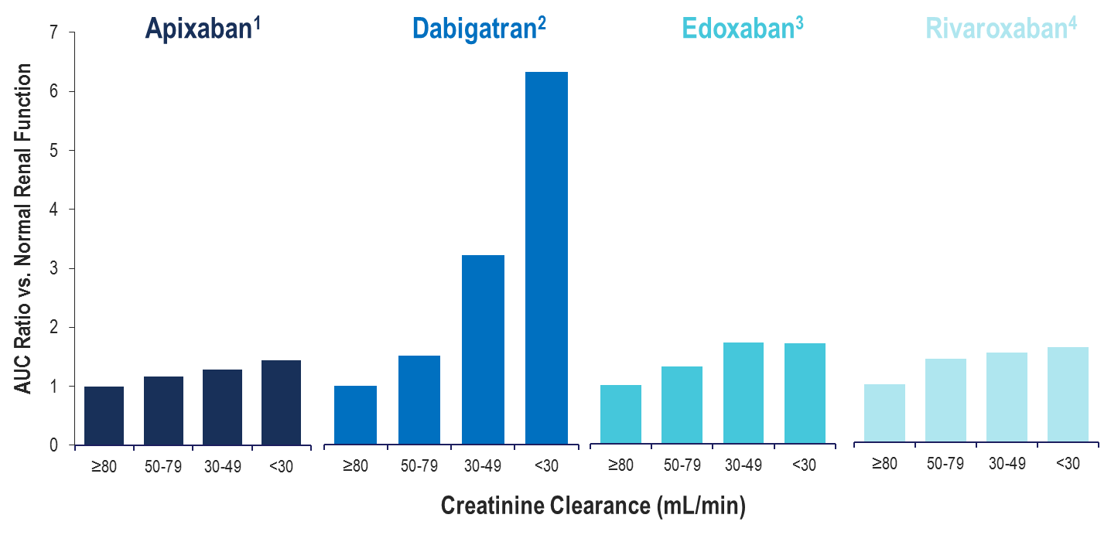
Total Drug Exposure (AUC) with Declining Renal Function
CL_{R}27%
CL_{R}85%
CL_{R}50%
CL_{R}33%
Normal Renal Function: ≥80 mL/min; Mild Renal Impairment: 50-79 mL/min
Moderate Renal Impairment: 30-49 mL/min; Severe Renal Impairment: <30 mL/min
Apixaban (Eliquis) Product Monograph. Bristol-Meyers Squibb Canada;
Dabigatran (Pradaxa) Product Monograph. Boehringer Ingelheim Canada Ltd.;
Edoxaban (Lixiana) Product Monograph. Progress Therapeutics;
Rivaroxaban (Xarelto) Product Monograph. Bayer Inc.
Notes:
Speaker Notes:
Altered renal elimination of the DOACs impacts drug exposure. Increased drug exposure is observed with declining renal function, with dabigatran being impacted to the greatest extent.

Slide 15
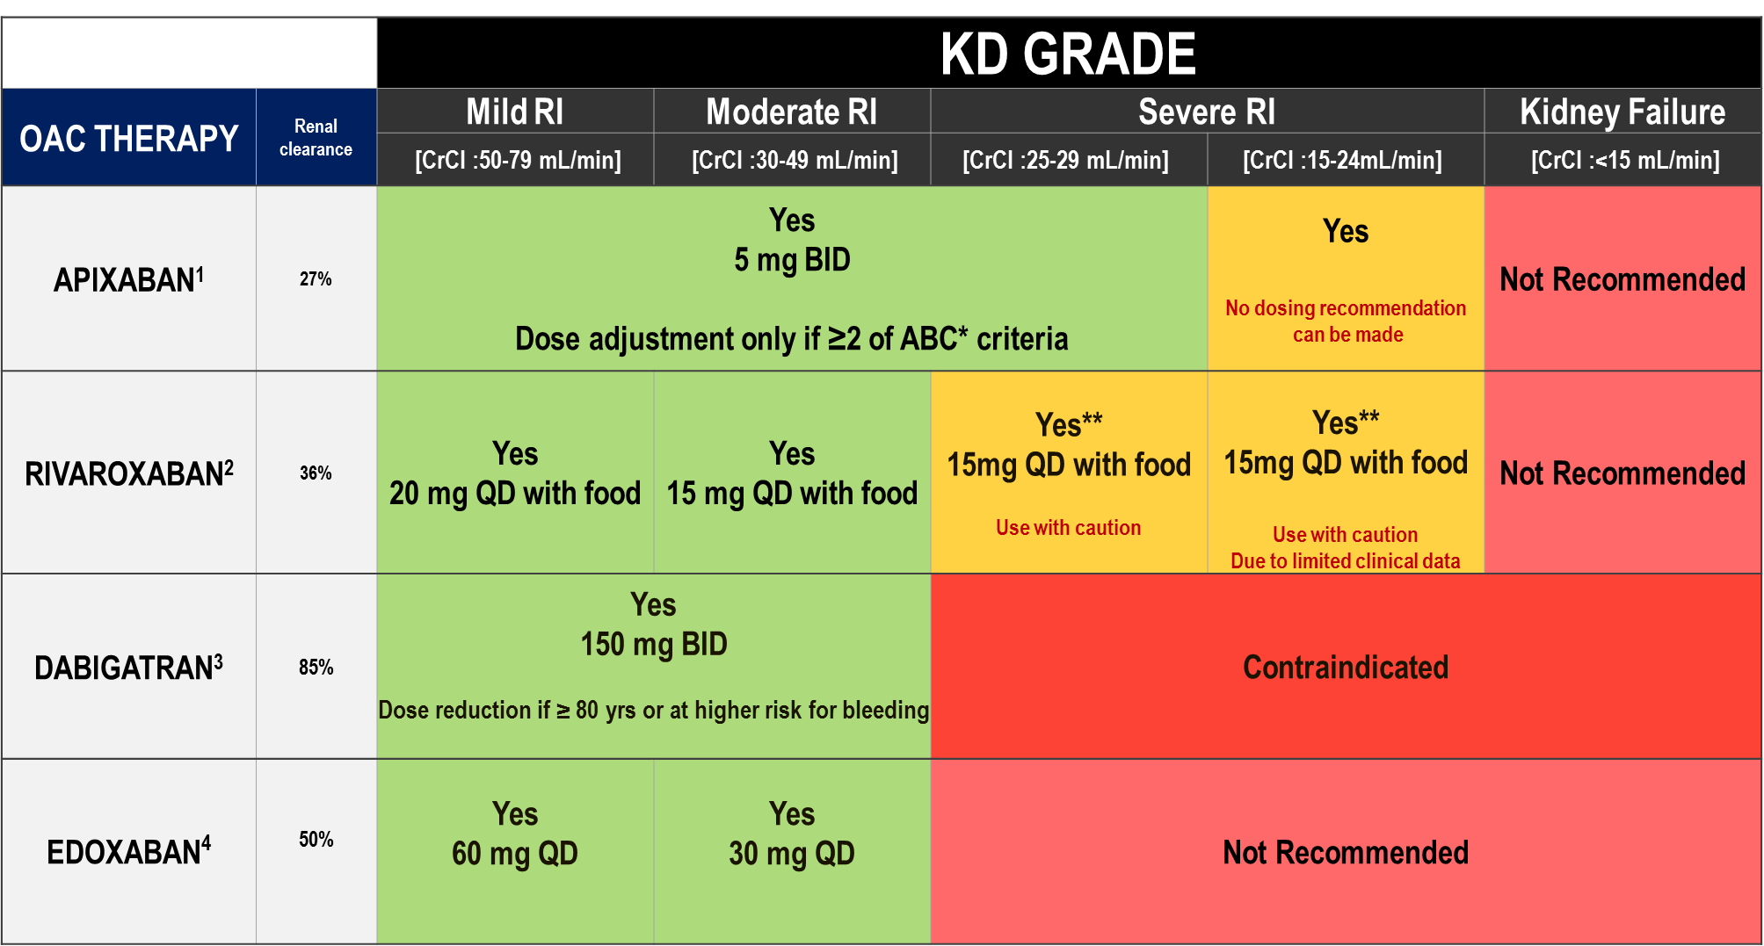
DOAC Dosing Recommendations for Stroke Prevention in AF in Patients with Renal Impairment According to the Canadian Product Monographs
Pfizer Canada Inc./BMS Canada. Eliquis (apixaban) Product Monograph, 2018.
Boehringer Ingelheim Canada Ltd. Pradaxa (dagbatran) Product Monograph. August 11, 2016.
Bayer Inc. Xarelto (rivaroxaban) Product Monograph. 2018.
Daiichi Sankyp Inc. Lixiana (edoxaban) Product Monograph. 2017.
Notes:
Speaker Notes:
*ABC criteria: Dose reduction to 2.5 mg BID if at least 2 of the following: Age ≥ 80, Body weight ≤ 60kg, serum Creatinine ≥ 133 micromol/L (1.5 mg/dL)
**Moderate renal impairment: Use with caution especially in those concomitantly receiving other drugs which increase rivaroxaban plasma concentrations, consider the benefit/risk of anticoagulant therapy before administering rivaroxaban to patients with moderate renal impairment having a creatinine clearance close to the severe renal impairment category (CrCl < 30 mL/min), or in those with a potential to have deterioration of renal function to severe impairment during therapy.
DOAC, non-vitamin K antagonist oral anticoagulant; AF, atrial fibrillation; CrCL, estimated creatinine clearance

Slide 16
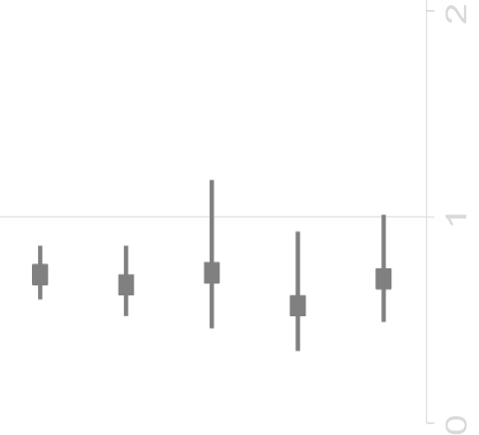
Rates of ISTH Major Bleeding* by Treatment and Dose-Reduction Criteria
Subgroup | Apixaban (%/year) | Warfarin (%/year) | HR (95% CI)
No DR criteria | 204 (1.8) | 279 (2.5) | 0.7 (0.6–0.9)
1 DR criterion | 102 (3.2) | 145 (4.8) | 0.7 (0.5–0.9)
Creatinine ≥1.5 mg/dL | 30 (4.2) | 40 (5.8) | 0.7 (0.5–1.2)
Weight ≤60 kg | 26 (2.3) | 44 (4.0) | 0.6 (0.4–0.9)
Age ≥80 years | 46 (3.5) | 61 (4.9) | 0.7 (0.5–1.1)
P_{interaction} = 0.71
0
1
2
Apixaban better
Warfarin better
*Primary outcome.
CI, confidence interval; DR, dose reduction; HR, hazard ratio; ISTH, International Society on Thrombosis and Haemostasis.
Alexander JH, et al, JAMA Cardiol 2016
Notes:
Speaker Notes:
This slide shows the rates of major bleeding by treatment and dose-reduction criteria.
Irrespective of the presence of 1 or no dose-reduction criteria, the treatment effect of apixaban 5 mg BID vs warfarin for the outcome of major bleeding was consistent with the overall results (P_{interaction} = 0.71).
The effect of apixaban 5 mg BID compared with warfarin on the risk of major bleeding was consistent across the range of age, weight, and creatinine clearance observed in the ARISTOTLE population.

Slide 17
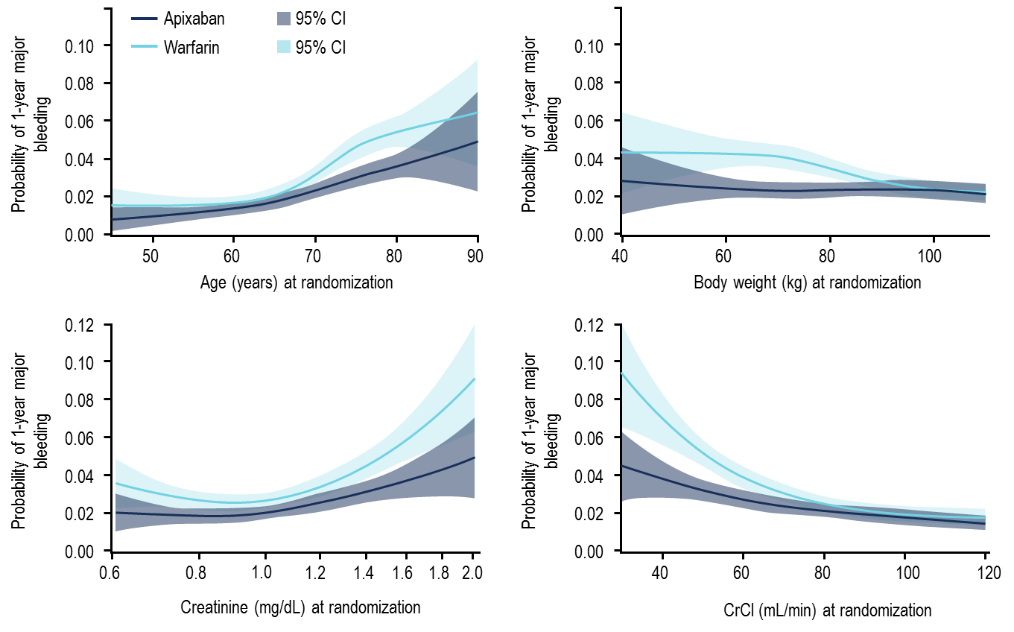
ISTH Major Bleeding Over 1 Year by Treatment and Dose-Reduction Criteria
CI, confidence interval; CrCl, creatinine clearance; ISTH, International Society on Thrombosis and Haemostasis.
Alexander JH, et al, JAMA Cardiol 2016
Notes:
Speaker Notes:
This slide shows the probability and 95% CI of major bleeding over 1 year among subjects assigned to apixaban and warfarin across the spectrum of age, body weight, creatinine level, and estimated CrCl observed at randomization in the ARISTOTLE trial.
Compared with warfarin, apixaban was consistently associated with a numerically lower risk of major bleeding across the spectrum of age, weight, creatinine level, and CrCl.
Subjects with older age, lower body weight, elevated creatinine level, and lower CrCl tended to have greater relative reductions in major bleeding with apixaban compared with warfarin than subjects with younger age, higher body weight, lower creatinine level, and higher CrCl.

Slide 18
Case 9
You prescribed Apixaban 2.5 mg BID to Jean Bella due to two of the ABC criteria being met:
She is 84 years old and her weight is 58 kg
Notes:
Speaker Notes:

Slide 19
What if Jean Bella’s weight increased to 68 kg. Would you keep her at this dose?
Select from one available options
Yes, I would keep her on apixaban 2.5 mg bid (safer)
No, would increase the dose to 5 mg bid
I would refer to a specialist for advice
Notes:
Speaker Notes:

Slide 20
ARISTOTLE: Outcomes by Treatment Among Subjects with One and No Dose-Reduction Criteria
Outcome | Subgroup | Apixaban Events (%/year) N=8665* | Warfarin Events (%/year) N=8657* | Apixaban vs. Warfarin HR (95% CI) | P_{interaction}
Stroke / SE | 1 DR criterion No DR criterion | 63 (1.80) 137 (1.10) | 67 (1.93) 176 (1.42) | 0.94 (0.66-1.32) 0.77 (0.62-0.97) | 0.36
Ischemic/unspecified stroke | 1 DR criterion No DR criterion | 52 (1.49) 100 (0.80) | 43 (1.23) 118 (0.95) | 1.21 (0.81-1.81) 0.84 (0.65-1.10) | 0.14
All-cause death | 1 DR criterion No DR criterion | 205 (5.74) 322 (2.52) | 197 (5.50) 390 (3.07) | 1.04 (0.86-1.27) 0.82 (0.71-0.95) | 0.054
CV death | 1 DR criterion No DR criterion | 101 (2.83) 173 (1.35) | 97 (2.71) 201 (1.58) | 1.04 (0.79-1.38) 0.86 (0.70-1.05) | 0.26
* Includes subjects randomized to apixaban 5 mg BID (standard dose)
CI = Confidence Interval; CV = Cardiovascular; DR = Dose Reduction; HR = Hazard Ratio; SE = Systemic Embolism
Alexander JH, et al, JAMA Cardiol 2016
Notes:
Speaker Notes:

Slide 21

Case 9
What are some of the misconceptions about DOAC doses?
Notes:
Speaker Notes:

Slide 22
Misconceptions About DOAC Doses
Misconceptions about DOAC dosing results in the underutilization of DOACs but also the excessive and/or inappropriate use of the reduced doses
Physicians choosing a lower dose of a DOAC are often driven out of fear of causing a bleed
Nonetheless, by lowering the dose of a DOAC, or not anticoagulating at all, patients are at higher risk for stroke because of inadequate treatment
Physicians perceive older patients with AF having a stroke as the natural course of the disease vs. causing a bleed as a result of their actions
Notes:
Speaker Notes:

Slide 23
Case 9
What is the impact of inappropriate dosing?
Notes:
Speaker Notes:

Slide 24
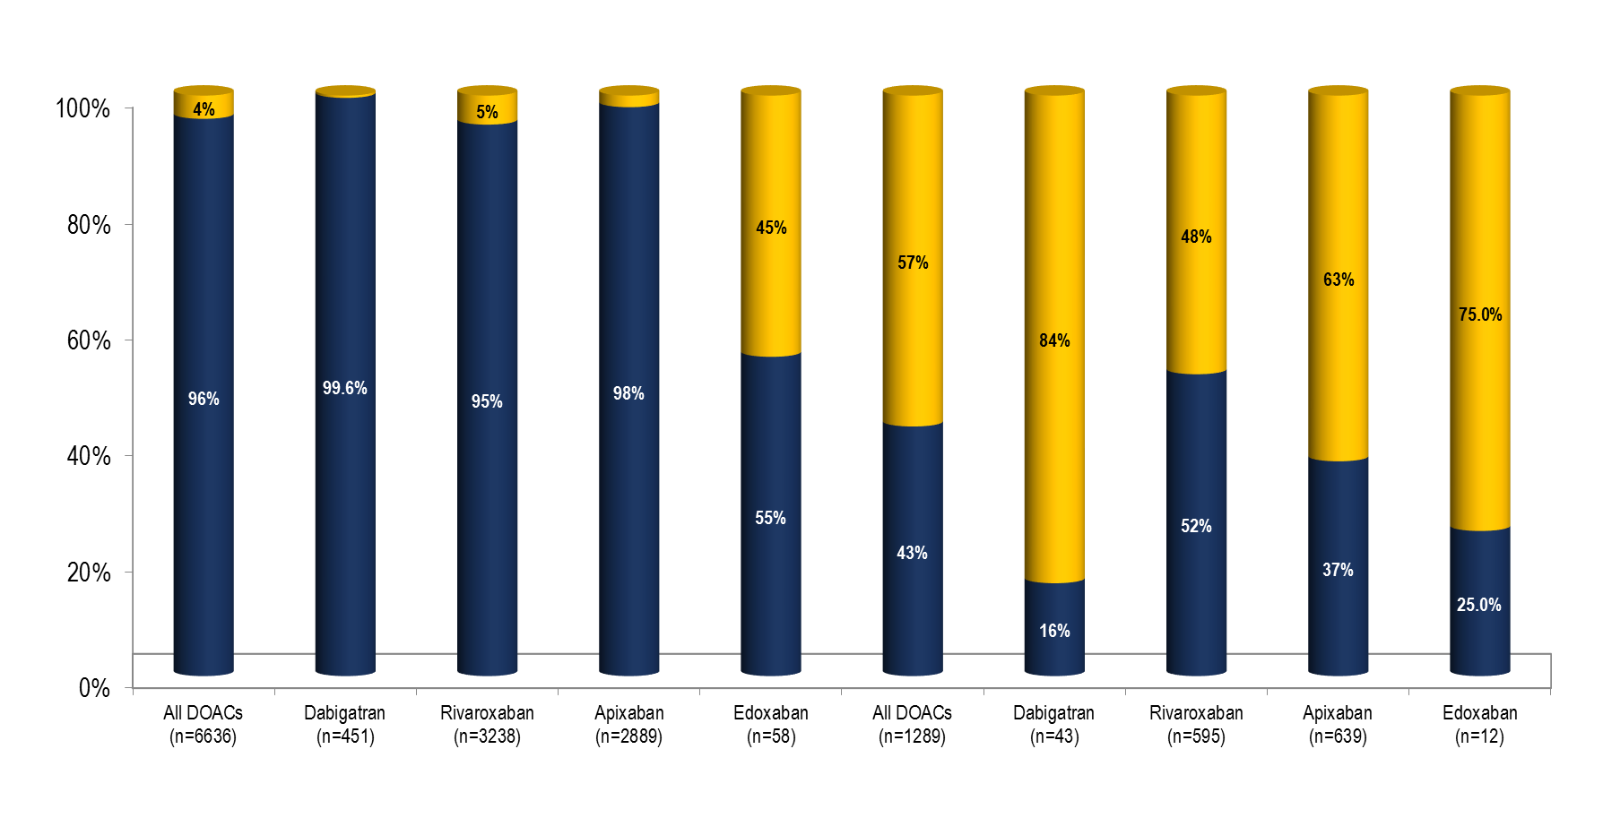
Frequency and Outcomes of Reduced Dose DOACs: Result From ORBIT-AF II
Appropriate
Inappropriate
Standard Dose
Reduced Dose
Underdosing is common: 50% of patients treated with low dose DOACs should be on high dosage
Steinberg BA, et al. J Am Heart Assoc. 2018 Feb 16;7(4)
Notes:
Speaker Notes:
Abstract
BACKGROUND:
Non-vitamin K antagonist oral anticoagulants (NOACs) are indicated for stroke prevention in atrial fibrillation (AF) but require lower doses in certain patients. We sought to describe the frequency, appropriateness (according to Food and Drug Administration labeling), and outcomes of patients prescribed reduced doses of NOACs in community practice.
METHODS AND RESULTS:
We analyzed data from the ORBIT-AF II (The Outcomes Registry for Better Informed Treatment of Atrial Fibrillation II) registry, a prospective, national, observational registry of AF patients. Among 7925 AF patients receiving NOACs, we assessed patterns of use of reduced NOAC doses and associated cardiovascular and bleeding outcomes at median follow-up of 1 year. Overall, 6636 patients (84%) received a NOAC at standard dose, which was consistent with US Food and Drug Administration labeling in 6376 (96%). Reduced NOAC dose was prescribed to 1289 (16% overall), which was consistent with Food and Drug Administration labeling in only 555 patients (43%). Compared with those whose NOAC dose was appropriately reduced, patients receiving inappropriate dose reductions were younger (median age 79 versus 84, P<0.0001) and had lower ORBIT bleeding risk scores (26% ≥4 versus 45%, P<0.0001). Compared with those appropriately receiving standard dosing, patients receiving inappropriately reduced-dose NOACs had higher unadjusted rates of thromboembolic events (2.11 versus 1.35 events per 100 patient years, hazard ratio 1.56, 95% confidence interval 0.92-2.67) and death (6.77 versus 2.60, hazard ratio 2.61, 95% confidence interval 1.86-3.67). After adjustment, outcomes were not significantly different but tended to favor patients dosed appropriately.
CONCLUSIONS:
The majority of dose reductions of NOACs in AF are inconsistent with US Food and Drug Administration recommendations. There appear to be opportunities to improve current NOAC dosing in community practice.

Slide 25
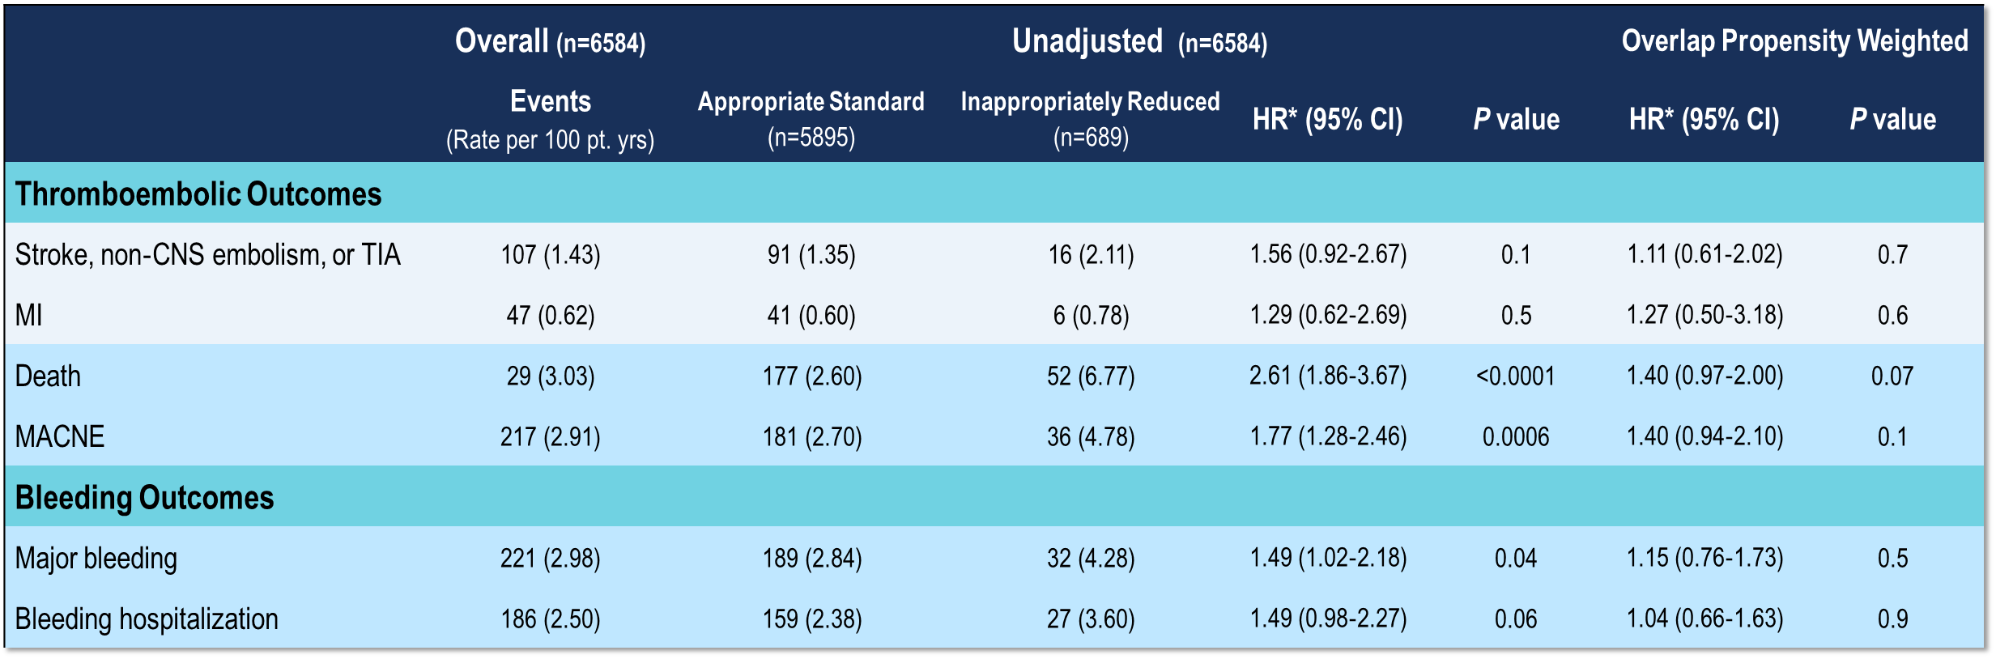
Frequency and Outcomes of Reduced Dose DOACs: Result From ORBIT-AF II
Reduced‐dose DOAC does not appear to be associated with bleeding risk.
Patients receiving lower DOAC doses are an at‐risk group and have high rates of adverse events.
Steinberg BA, et al. J Am Heart Assoc. 2018 Feb 16;7(4)
Notes:
Speaker Notes:
A significant proportion of AF patients receiving DOACs are receiving the reduced dose; however, the majority of reduced‐dose DOAC use is not consistent with FDA recommendations. Moreover, selection of reduced‐dose DOAC therapy does not appear to be associated with bleeding risk. Patients receiving lower DOAC doses are an at‐risk group and have high rates of adverse events. These data support the need for ongoing education of clinicians in community practice on the appropriate dosing of DOACs for AF and further study of the outcomes associated with reduced DOAC doses.

Slide 26
Case 9
What are the patterns of reduced dose use in Canada?
Notes:
Speaker Notes:

Slide 27
Appropriate Use of Antithrombotic Medications in Canadian Patients with NVAF
7,019 patients with NVAF from 735 primary care physician practices
Over 90% of patients with CHADS₂ >1 receiving oral anticoagulation
BUT ….
Over 50% of patients on OAC taking warfarin
30.9% of patients on warfarin TTR < 65%
Of the patients on DOACs, 11.7% were on the wrong dose
7.4% under-dosed
4.3% over-dosed
Additional 3.2% of patients on DOAC were contraindicated by renal function
NVAF: Non Valvular Atrial Fibrillation
Bell AD, et al. Am J Cardiol. 2016 Apr 1;117(7):1107-11
Notes:
Speaker Notes:

Slide 28
OPTIMAL AF: Background
The OPTIMAL-AF program was a knowledge translation and quality improvement initiative coordinated by the Canadian Heart Research Centre.
The OPTIMAL AF program aimed to:
identify the proportion on CCS AF Guideline-recommended OAC;
estimate the rate of NOAC dosing that is lower- and higher-than-recommended (i.e., concordant with Health Canada Product Monograph prescribing recommendations); and,
understand the reasons why patients receive reduced NOAC doses.
1641 Canadian NVAF patients (EMR n=1087, Paper-based n=554) were enrolled by 102 physicians (91 Primary Care Physicians [n=1522], 11 Cardiologists/Internists [n=119]) in 8 provinces
NVAF: Non Valvular Atrial Fibrillation
Non-vitamin K antagonist Oral Anticoagulant (NOAC) Use and Dosing in Canadian Practice: Insights from the Optimizing PharmacoTherapy in the Management Approach to Lowering risk in Atrial Fibrillation (OPTIMAL-AF) Program - CCS 2018 Poster Presentation
Notes:
Speaker Notes:
Methods
The OPTIMAL-AF program was a knowledge translation and quality improvement initiative. It was based on chart audit data collection and subsequent feedback to physicians regarding their stroke prevention management in an effort to support their choice (and dose) of therapies and thereby better achieve evidence-based, guideline-recommended antithrombotic treatment in NVAF patients. Canadian primary care physicians (PCPs) and specialists (Cardiology and Internal Medicine) were invited to participate and agreed to provide anonymized patient chart audit data through either an electronic medical record (EMR) system (TELUS Health® Platforms/Practice Solutions/Med Access, Montreal, Canada) or standardized, paper-based data collection forms. Central Research Ethics Board approval was obtained to allow for the waiver of individual patient informed consent and the publication of aggregate data.
A steering committee comprised of 3 cardiologists and 11 primary care physicians (PCPs) provided input on the program objectives, design, protocol, chart audit forms and feedback process. The Canadian Heart Research Centre (CHRC; Toronto, Canada), a not-for-profit academic research organization, was responsible for the coordination of the program, including statistical analysis. Support for the program was provided through an unrestricted grant from the Bristol Myers Squibb/Pfizer Canada alliance.
Participating physicians provided anonymized patient data either through: (1) a single page, paper-based data collection form (faxed or mailed, and then scanned into a database using TELEform [version 10.0; Cardiff Software Inc., San Diego, California]); or, (2) via automatic abstraction from the electronic medical record The physicians then validated that the identified patients indeed had NVAF and were currently receiving OAC. Physicians participating in the paper-based chart audits were recruited to participate by email and identified through continuing medical education events, participation in previous or ongoing clinical trials, observational studies, or knowledge translation programs with the coordinating centre. Physicians providing paper- based data collection forms submitted data for 10 patients with NVAF from their practice. While physicians were encouraged to include consecutive patients, patients receiving warfarin could not comprise more than 20% of the sample. For the data obtained through the EMR process, all patients in the physician’s practice meeting the eligibility criteria were included.
Patients were eligible for inclusion if they were 18 years of age or older; had permanent, paroxysmal or persistent non-valvular AF (or atrial flutter) identified on a 12-lead electrocardiogram (ECG), rhythm strip, pacemaker/ implantable cardioverter-defibrillator, or continuous ECG recording with >30 seconds of continuous AF and were currently receiving OAC. Patients were excluded if they had any of: mechanical heart valve, rheumatic mitral stenosis, or moderate or severe non-rheumatic mitral stenosis; severe renal dysfunction (creatinine clearance <20 ml/min/m2) or an apparent reversible cause of AF.
Patient data collected included demographics, medical history, current medications and treatments; and dose of NOAC. For patients receiving warfarin, the most recent INR value was recorded, and time-in-therapeutic-range (TTR) was calculated for the paper-based chart audit patients based upon the last 6 INR values obtained. For patients receiving a reduced dose of a NOAC, concordance with the recommended dose per the Health Canada product monograph (Supplementary Appendix D) was determined. In the case of the reduced dose being discordant, the reason for the reduced dose was recorded. For the paper-based patients, data was also available regarding AF history, concurrent specialists or services co-managing the patient’s stroke prevention therapy (such as anticoagulation clinic) and antithrombotic drug coverage (i.e., provincial/national formulary, private insurance, both, or neither).
Descriptive analysis of demographic variables, regional distribution of patients and physicians, data related to medical history, OAC therapies, doses and reasons for discordant doses were performed using SAS software v. 9.4 (SAS Institute, Cary, North Carolina, United States).
Results
The total number of patients receiving OAC was 1681. Detailed demographic data was provided for 1641 patients by 102 physicians from 8 provinces (Supplementary Appendices A and E); 1087 patients (66%) were included via the EMR process and 554 (34%) via the paper-based method. Medical history details are listed in Table 1.There were 635 (39%) women and 90% (1477) of the patients were 65 years of age or older.
In the paper-based chart audit patients, the median (25th, 75th percentiles) CHADS₂, CHA₂DS₂VaSC, and HASBLED scores were 2 (1, 3), 4 (3, 5) and 2 (1, 2), respectively. In the EMR patients with known CHADS-65 status, 96% met the threshold for initiation of OAC for stroke prevention. As per inclusion criteria and seen in Table 2, all patients were receiving OAC: warfarin in 302 (18%) and NOAC in 1379 (84%). In the EMR-based patients, where no pre-defined cap on inclusion of patients on VKA therapy was in place, 87% were receiving a NOAC. For the paper-based chart audit patients (n=479), antithrombotic drug coverage was available from: provincial/federal (79.1%), private (10.4%), both (7.1%), and none (3.3%), respectively. Concomitant antiplatelet (APT) therapy was used in 139 patients (8.5%). Concomitant therapies are listed in Supplementary Appendix B.
For patients receiving warfarin (n= 302), the most recent INR was available in 259 (86%) patients and was within the therapeutic range of 2 to 3 in 178 (69%), less than 2 in 45 (17%) and above 3 in 36 (14%). For paper-based chart audit patients, data on the 6 most recent INRs were available in 62 patients and the corresponding median (25th, 75th percentiles) TTR was 87 (68, 100).
For patients receiving a NOAC (n=1379), more than 95% of patients met the CHADS-65 threshold for OAC. The distribution of NOAC agents was: 661 (48%) patients receiving apixaban, 243 (18%) dabigatran, 468 (34%) rivaroxaban, and 7 (<1%) edoxaban, respectively . The dose of NOAC was available in 1113 patients (81%): standard dose was prescribed in 849 (76%) and reduced dose in 264 (24%). Among those, the reduced dose was concordant with Health Canada prescribing information in 154 patients (58%). The standard dose was concordant in 805 (95%). Thus, 14% of patients on NOACs where the dose could be determined were receiving a dose discordant with prescribing recommendations; 10% were on a lower than recommended dose, and 4% were on a standard dose that should have been reduced. The breakdown of NOAC by dose and concordance is detailed in Table 2.
Non-mutually exclusive reasons for the use of discordant reduced doses of NOAC (110 patients) are listed in Table 3. The top three reasons cited by the physicians providing paper-based data were age 80 years or more (58%), elevated creatinine (Creatinine 133 µmol/L or greater or eGFR less than 50 ml/min/1.73 m²) (35%), and prior bleeding or dose recommended by specialist (17% each). For the EMR-based patients, the top 3 reasons physicians provided for discordant reduced NOAC doses were elevated creatinine/low eGFR (36%), dose recommended by specialist (29%), and high bleeding risk (22%). Of note, age of 80 years or more was not available as a specific reason in the EMR
Characteristics of the paper-based patients by NOAC are listed in Supplementary Appendix C.

Slide 29
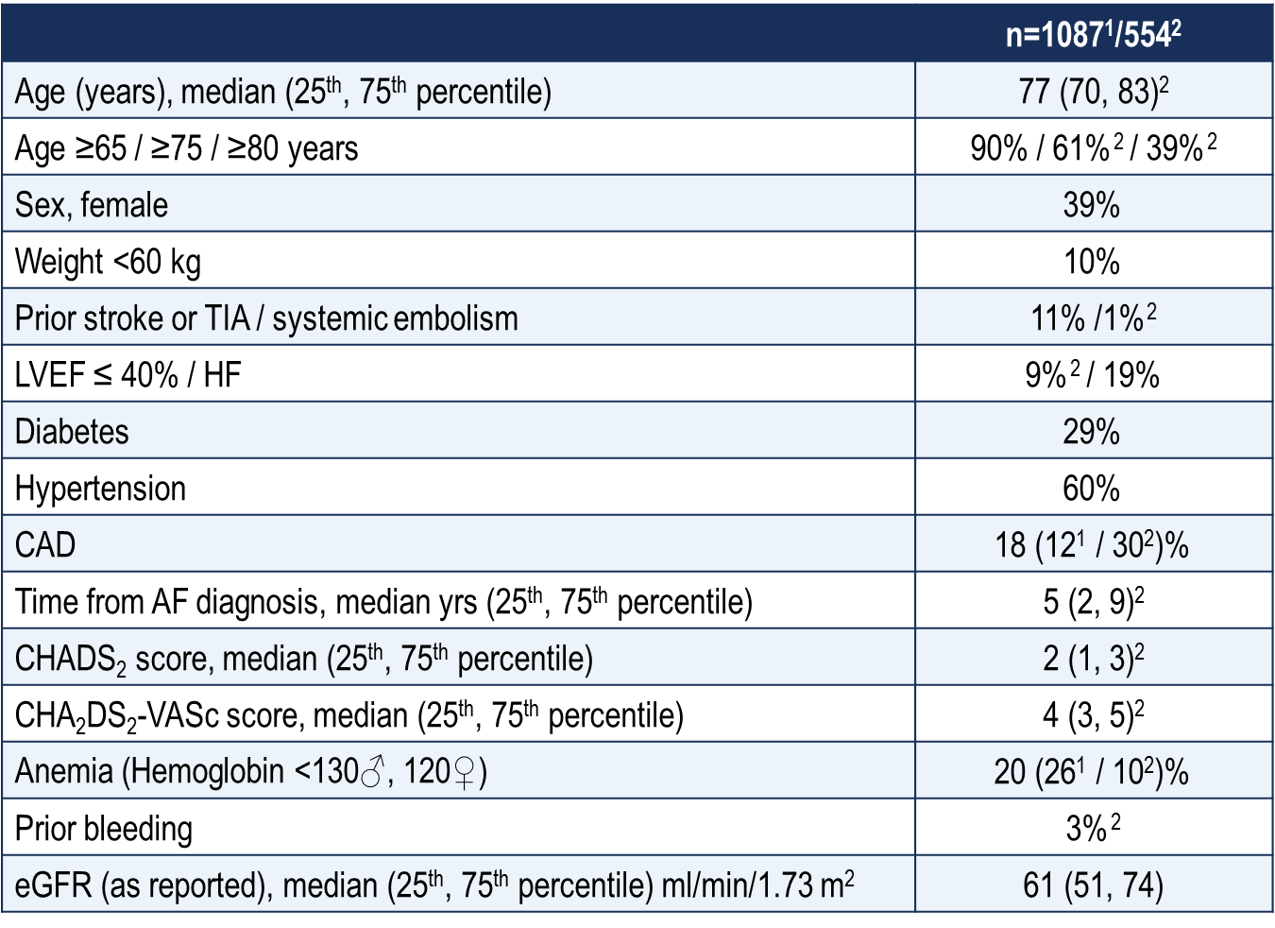
OPTIMAL AF: Patient Characteristics
Non-vitamin K antagonist Oral Anticoagulant (NOAC) Use and Dosing in Canadian Practice: Insights from the Optimizing PharmacoTherapy in the Management Approach to Lowering risk in Atrial Fibrillation (OPTIMAL-AF) Program - CCS 2018 Poster Presentation
Notes:
Speaker Notes:
Methods
The OPTIMAL-AF program was a knowledge translation and quality improvement initiative. It was based on chart audit data collection and subsequent feedback to physicians regarding their stroke prevention management in an effort to support their choice (and dose) of therapies and thereby better achieve evidence-based, guideline-recommended antithrombotic treatment in NVAF patients. Canadian primary care physicians (PCPs) and specialists (Cardiology and Internal Medicine) were invited to participate and agreed to provide anonymized patient chart audit data through either an electronic medical record (EMR) system (TELUS Health® Platforms/Practice Solutions/Med Access, Montreal, Canada) or standardized, paper-based data collection forms. Central Research Ethics Board approval was obtained to allow for the waiver of individual patient informed consent and the publication of aggregate data.
A steering committee comprised of 3 cardiologists and 11 primary care physicians (PCPs) provided input on the program objectives, design, protocol, chart audit forms and feedback process. The Canadian Heart Research Centre (CHRC; Toronto, Canada), a not-for-profit academic research organization, was responsible for the coordination of the program, including statistical analysis. Support for the program was provided through an unrestricted grant from the Bristol Myers Squibb/Pfizer Canada alliance.
Participating physicians provided anonymized patient data either through: (1) a single page, paper-based data collection form (faxed or mailed, and then scanned into a database using TELEform [version 10.0; Cardiff Software Inc., San Diego, California]); or, (2) via automatic abstraction from the electronic medical record The physicians then validated that the identified patients indeed had NVAF and were currently receiving OAC. Physicians participating in the paper-based chart audits were recruited to participate by email and identified through continuing medical education events, participation in previous or ongoing clinical trials, observational studies, or knowledge translation programs with the coordinating centre. Physicians providing paper- based data collection forms submitted data for 10 patients with NVAF from their practice. While physicians were encouraged to include consecutive patients, patients receiving warfarin could not comprise more than 20% of the sample. For the data obtained through the EMR process, all patients in the physician’s practice meeting the eligibility criteria were included.
Patients were eligible for inclusion if they were 18 years of age or older; had permanent, paroxysmal or persistent non-valvular AF (or atrial flutter) identified on a 12-lead electrocardiogram (ECG), rhythm strip, pacemaker/ implantable cardioverter-defibrillator, or continuous ECG recording with >30 seconds of continuous AF and were currently receiving OAC. Patients were excluded if they had any of: mechanical heart valve, rheumatic mitral stenosis, or moderate or severe non-rheumatic mitral stenosis; severe renal dysfunction (creatinine clearance <20 ml/min/m2) or an apparent reversible cause of AF.
Patient data collected included demographics, medical history, current medications and treatments; and dose of NOAC. For patients receiving warfarin, the most recent INR value was recorded, and time-in-therapeutic-range (TTR) was calculated for the paper-based chart audit patients based upon the last 6 INR values obtained. For patients receiving a reduced dose of a NOAC, concordance with the recommended dose per the Health Canada product monograph (Supplementary Appendix D) was determined. In the case of the reduced dose being discordant, the reason for the reduced dose was recorded. For the paper-based patients, data was also available regarding AF history, concurrent specialists or services co-managing the patient’s stroke prevention therapy (such as anticoagulation clinic) and antithrombotic drug coverage (i.e., provincial/national formulary, private insurance, both, or neither).
Descriptive analysis of demographic variables, regional distribution of patients and physicians, data related to medical history, OAC therapies, doses and reasons for discordant doses were performed using SAS software v. 9.4 (SAS Institute, Cary, North Carolina, United States).
Results
The total number of patients receiving OAC was 1681. Detailed demographic data was provided for 1641 patients by 102 physicians from 8 provinces (Supplementary Appendices A and E); 1087 patients (66%) were included via the EMR process and 554 (34%) via the paper-based method. Medical history details are listed in Table 1.There were 635 (39%) women and 90% (1477) of the patients were 65 years of age or older.
In the paper-based chart audit patients, the median (25th, 75th percentiles) CHADS₂, CHA₂DS₂VaSC, and HASBLED scores were 2 (1, 3), 4 (3, 5) and 2 (1, 2), respectively. In the EMR patients with known CHADS-65 status, 96% met the threshold for initiation of OAC for stroke prevention. As per inclusion criteria and seen in Table 2, all patients were receiving OAC: warfarin in 302 (18%) and NOAC in 1379 (84%). In the EMR-based patients, where no pre-defined cap on inclusion of patients on VKA therapy was in place, 87% were receiving a NOAC. For the paper-based chart audit patients (n=479), antithrombotic drug coverage was available from: provincial/federal (79.1%), private (10.4%), both (7.1%), and none (3.3%), respectively. Concomitant antiplatelet (APT) therapy was used in 139 patients (8.5%). Concomitant therapies are listed in Supplementary Appendix B.
For patients receiving warfarin (n= 302), the most recent INR was available in 259 (86%) patients and was within the therapeutic range of 2 to 3 in 178 (69%), less than 2 in 45 (17%) and above 3 in 36 (14%). For paper-based chart audit patients, data on the 6 most recent INRs were available in 62 patients and the corresponding median (25th, 75th percentiles) TTR was 87 (68, 100).
For patients receiving a NOAC (n=1379), more than 95% of patients met the CHADS-65 threshold for OAC. The distribution of NOAC agents was: 661 (48%) patients receiving apixaban, 243 (18%) dabigatran, 468 (34%) rivaroxaban, and 7 (<1%) edoxaban, respectively . The dose of NOAC was available in 1113 patients (81%): standard dose was prescribed in 849 (76%) and reduced dose in 264 (24%). Among those, the reduced dose was concordant with Health Canada prescribing information in 154 patients (58%). The standard dose was concordant in 805 (95%). Thus, 14% of patients on NOACs where the dose could be determined were receiving a dose discordant with prescribing recommendations; 10% were on a lower than recommended dose, and 4% were on a standard dose that should have been reduced. The breakdown of NOAC by dose and concordance is detailed in Table 2.
Non-mutually exclusive reasons for the use of discordant reduced doses of NOAC (110 patients) are listed in Table 3. The top three reasons cited by the physicians providing paper-based data were age 80 years or more (58%), elevated creatinine (Creatinine 133 µmol/L or greater or eGFR less than 50 ml/min/1.73 m²) (35%), and prior bleeding or dose recommended by specialist (17% each). For the EMR-based patients, the top 3 reasons physicians provided for discordant reduced NOAC doses were elevated creatinine/low eGFR (36%), dose recommended by specialist (29%), and high bleeding risk (22%). Of note, age of 80 years or more was not available as a specific reason in the EMR
Characteristics of the paper-based patients by NOAC are listed in Supplementary Appendix C.

Slide 30
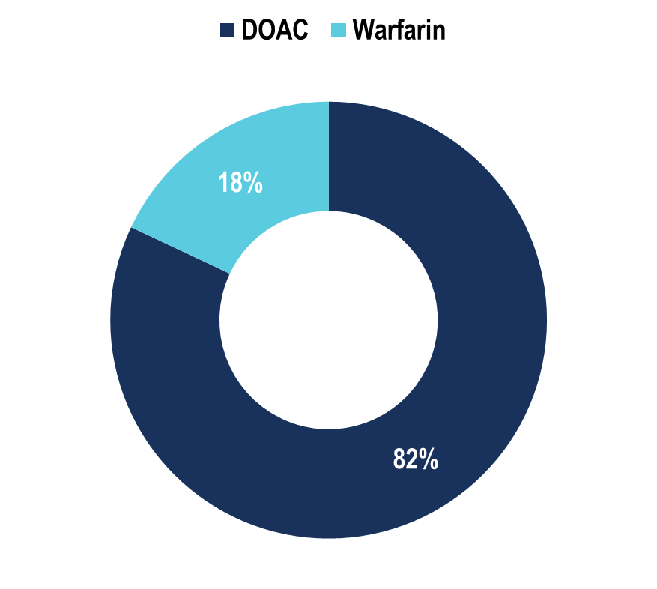
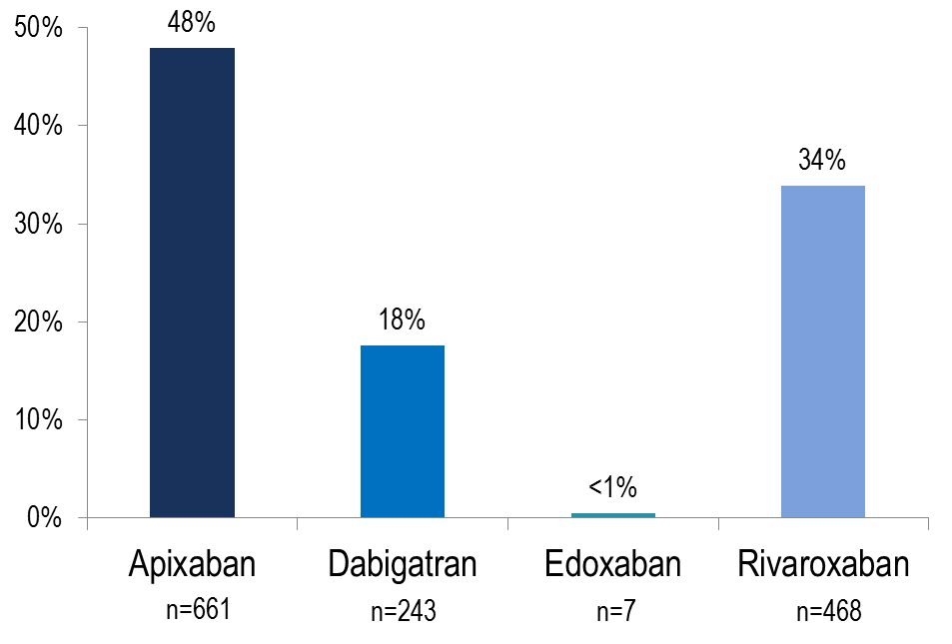
OPTIMAL AF: Oral Anticoagulant Used in Canada in 2018
n=1,681
n=1,379
Non-vitamin K antagonist Oral Anticoagulant (NOAC) Use and Dosing in Canadian Practice: Insights from the Optimizing PharmacoTherapy in the Management Approach to Lowering risk in Atrial Fibrillation (OPTIMAL-AF) Program - CCS 2018 Poster Presentation
Notes:
Speaker Notes:
More than 8 in 10 NVAF Canadian patients in our study are receiving DOAC for stroke prevention as per CCS AF Guideline recommendations

Slide 31
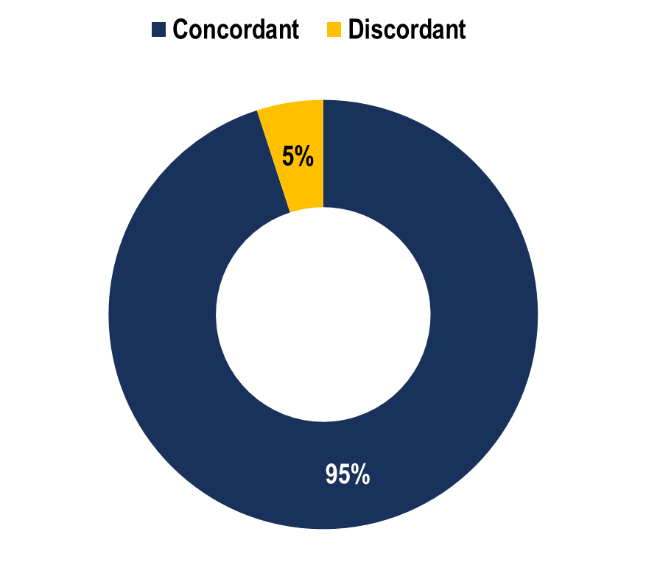
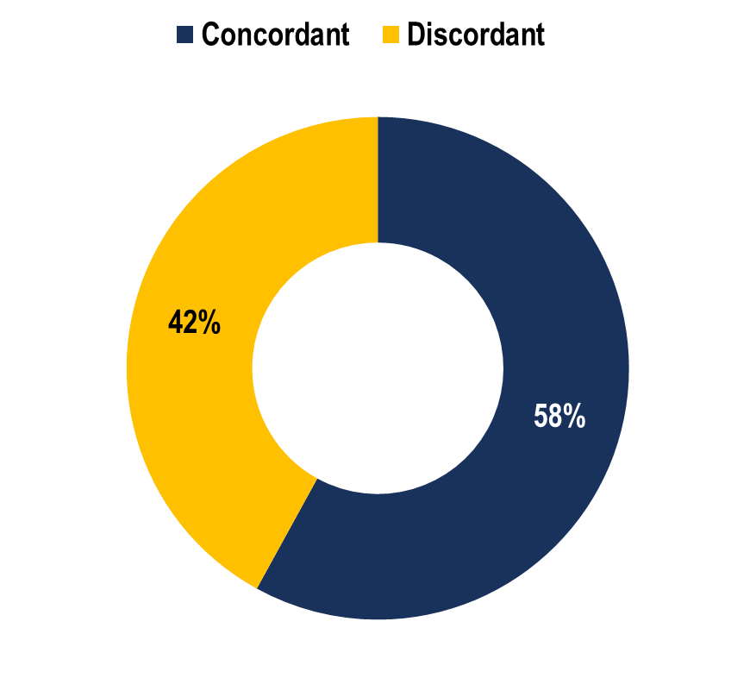
DOAC Dose and Concordance*
Standard Dose (n=829)
Reduced Dose (n=264)
*Concordant with Health Canada Product Monograph prescribing recommendations
⁺Dosing information available
Non-vitamin K antagonist Oral Anticoagulant (NOAC) Use and Dosing in Canadian Practice: Insights from the Optimizing PharmacoTherapy in the Management Approach to Lowering risk in Atrial Fibrillation (OPTIMAL-AF) Program - CCS 2018 Poster Presentation
Notes:
Speaker Notes:

Slide 32
DOAC Dose and Concordance*
Apixaban (n=556⁺)
Dabigatran (n=181⁺)
Rivaroxaban (n=369⁺)
*Concordant with Health Canada Product Monograph prescribing recommendations
⁺Dosing information available
Non-vitamin K antagonist Oral Anticoagulant (NOAC) Use and Dosing in Canadian Practice: Insights from the Optimizing PharmacoTherapy in the Management Approach to Lowering risk in Atrial Fibrillation (OPTIMAL-AF) Program - CCS 2018 Poster Presentation
Notes:
Speaker Notes:
Of the 556 AF patients on Apixaban, 23% were given the reduced dose of 2.5 mg bid of whom about half (13% of the total) did not have 2 of the 3 “ABC” criteria present (age ≥ 80, weight ≤ 60 kg, creatinine ≥ 133)
Of the 181 patients on Dabigatran, 38% were on the reduced dose of 110mg bid and only 4% were felt to be on a dosage that was discordant with current Canadian Guidelines
Of the 369 patients on Rivaroxaban, 18% were on a reduced dose and 8% were felt to have been reduced to 15 mg daily inappropriately.
Overall, the message is that there is some room for improvement through further knowledge dissemination

Slide 33
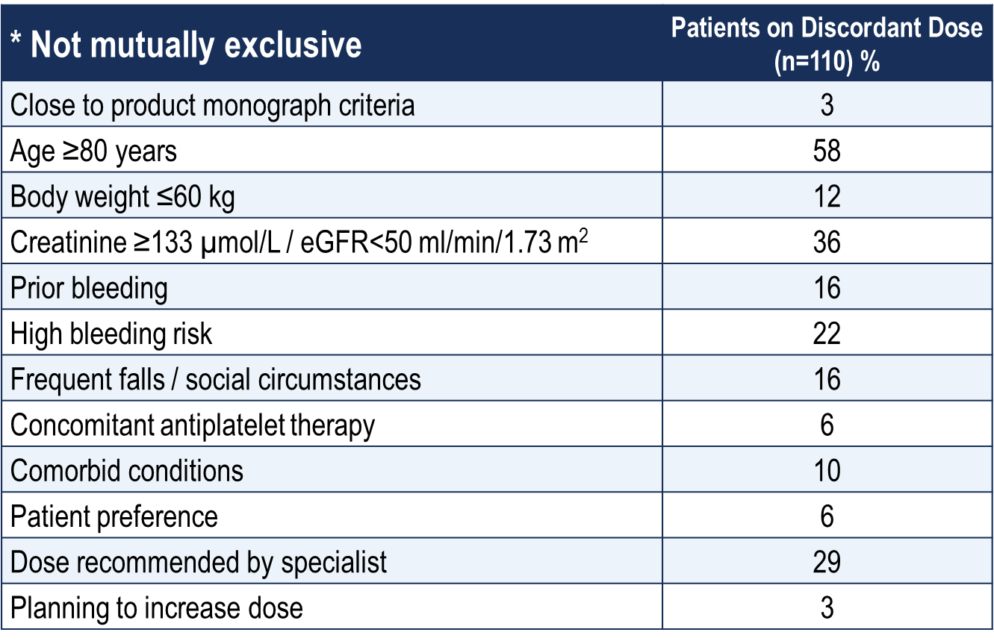
Rationale for Discordant Reduced DOAC Dose*
*Concordant with Health Canada Product Monograph prescribing recommendations
⁺Dosing information available
Non-vitamin K antagonist Oral Anticoagulant (NOAC) Use and Dosing in Canadian Practice: Insights from the Optimizing PharmacoTherapy in the Management Approach to Lowering risk in Atrial Fibrillation (OPTIMAL-AF) Program - CCS 2018 Poster Presentation
Notes:
Speaker Notes:

Slide 34
Case 9
What are the real-world outcomes in patents receiving reduced doses of DOACs?
Notes:
Speaker Notes:

Slide 35
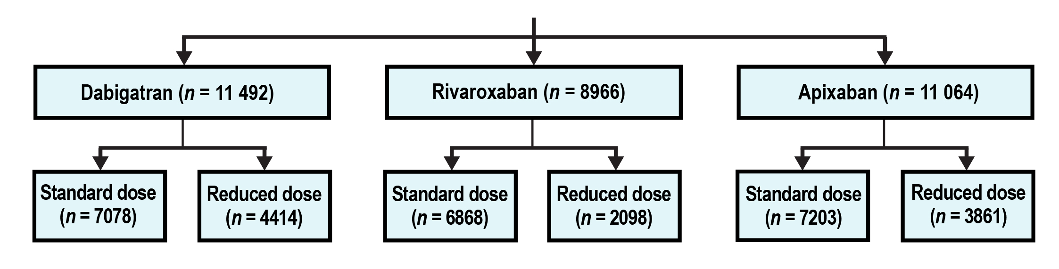
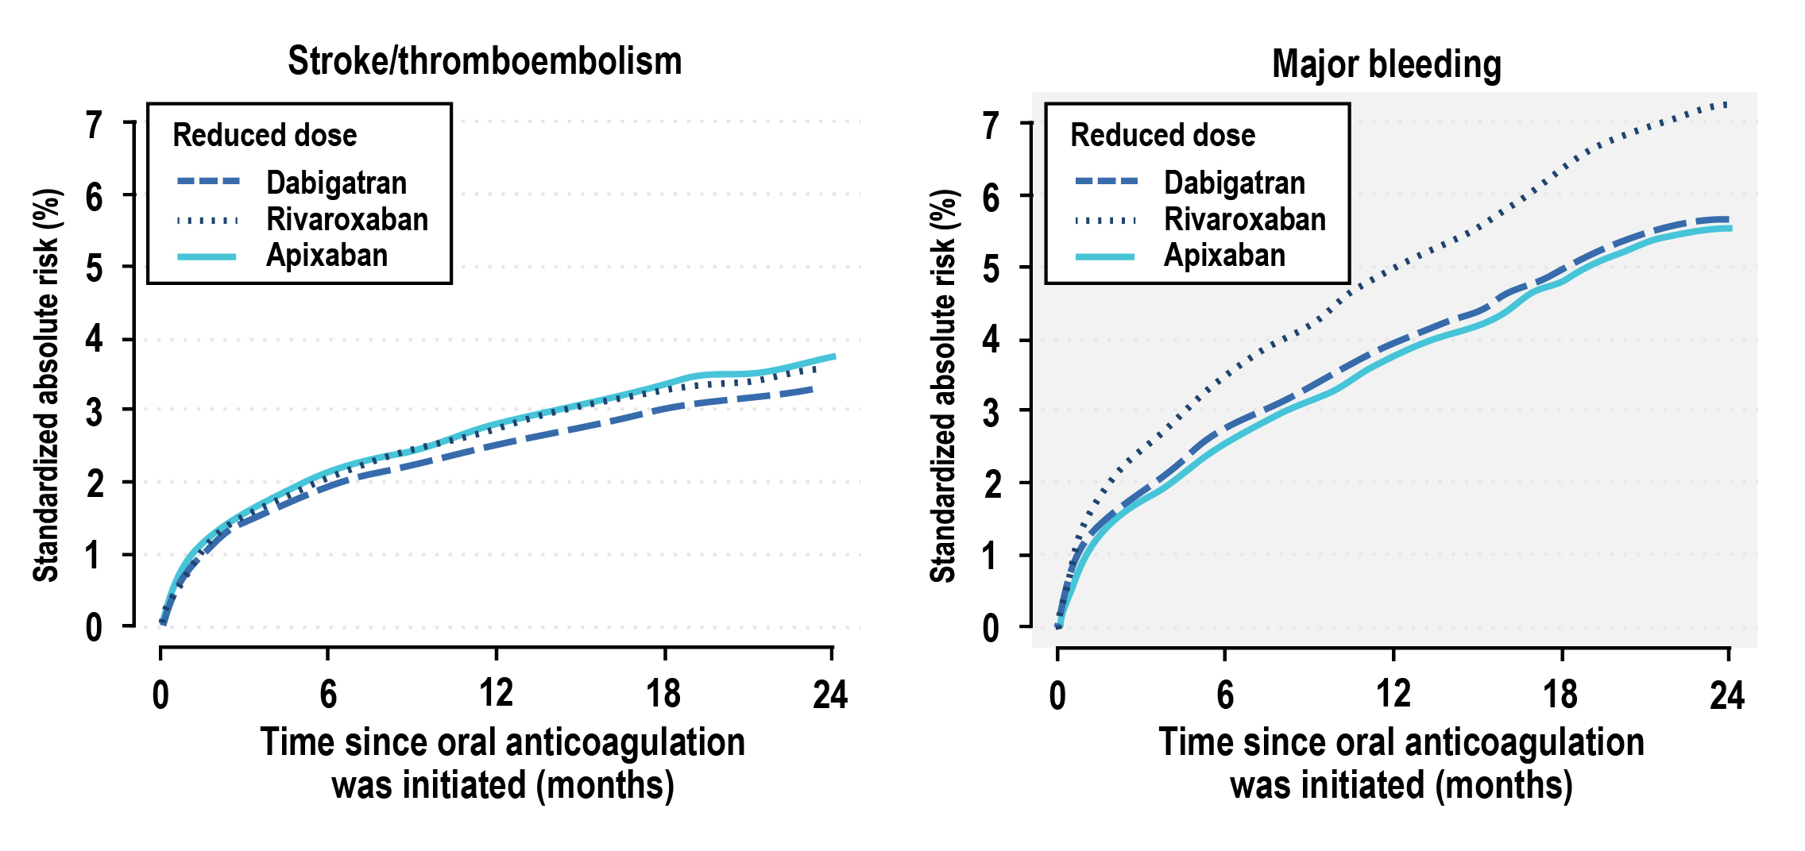
Standard and Reduced Doses of Dabigatran, Rivaroxaban and Apixaban for Stroke Prevention in AF: A National Cohort Study
*Head-to-head studies have not been conducted, therefore comparative safety and efficacy have not been established
Staerk et al. J Int Med, 2018 (283) 45-55
Notes:
Speaker Notes:
Background
Comparative data of non‐vitamin K antagonist oral anticoagulants (NOAC) are lacking in patients with atrial fibrillation (AF).
Objective
We compared effectiveness and safety of standard and reduced dose NOAC in AF patients.
Methods
Using Danish nationwide registries, we included all oral anticoagulant‐naïve AF patients who initiated NOAC treatment (2012–2016). Outcome‐specific and mortality‐specific multiple Cox regressions were combined to compute average treatment effects as 1‐year standardized differences in stroke and bleeding risks (g‐formula).
Results
Amongst 31 522 AF patients, the distribution of NOAC/dose was as follows: dabigatran standard dose (22.4%), dabigatran‐reduced dose (14.0%), rivaroxaban standard dose (21.8%), rivaroxaban reduced dose (6.7%), apixaban standard dose (22.9%), and apixaban reduced dose (12.2%). The 1‐year standardized absolute risks of stroke/thromboembolism were 1.73–1.98% and 2.51–2.78% with standard and reduced NOAC dose, respectively, without statistically significant differences between NOACs for given dose level. Comparing standard doses, the 1‐year standardized absolute risk (95% CI) for major bleeding was for rivaroxaban 2.78% (2.42–3.17%); corresponding absolute risk differences (95% CI) were for dabigatran −0.93% (−1.45% to −0.38%) and apixaban, −0.54% (−0.99% to −0.05%). The results for major bleeding were similar for reduced NOAC dose. The 1‐year standardized absolute risk (95% CI) for intracranial bleeding was for standard dose dabigatran 0.19% (0.22–0.50%); corresponding absolute risk differences (95% CI) were for rivaroxaban 0.23% (0.06–0.41%) and apixaban, 0.18% (0.01–0.34%).
Conclusions
Standard and reduced dose NOACs, respectively, showed no significant risk difference for associated stroke/thromboembolism. Rivaroxaban was associated with higher bleeding risk compared with dabigatran and apixaban and dabigatran was associated with lower intracranial bleeding risk compared with rivaroxaban and apixaban.

Slide 36
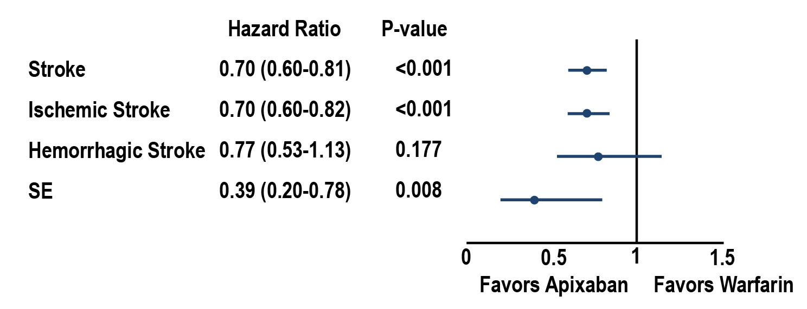
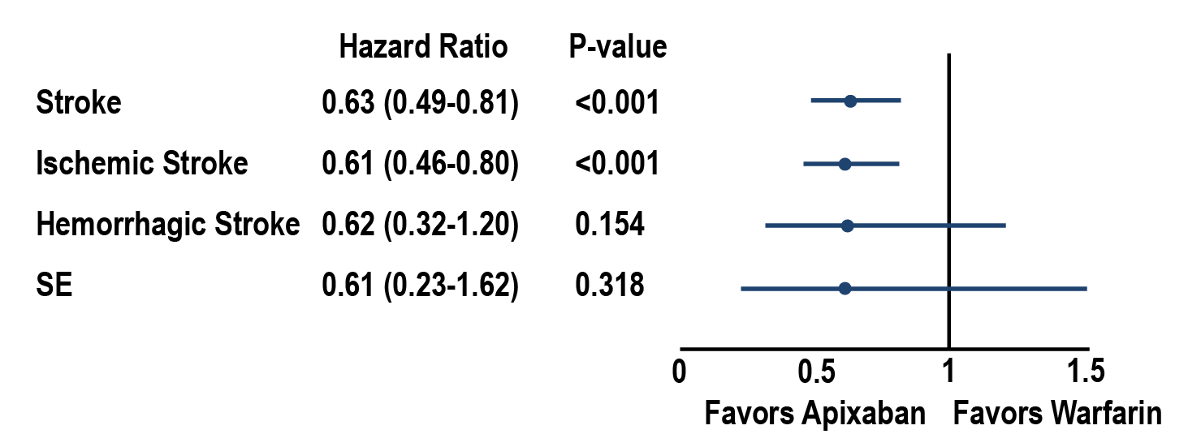
Apixaban 5 and 2.5 mg BID vs Warfarin for Stroke Prevention in NVADF:
Comparative Effectiveness and Safety
5 mg BID dose, matched patients
(n=63,654)
Apixaban (n=31,827)
Warfarin (n=31,827)
2.5 mg BID dose, matched patients
(n=13,200)
Apixaban (n=6,600)
Warfarin (n=6,600)
Li, and al. Apixaban 5 and 2.5 mg twice-daily vs warfarin for stroke prevention in NVAF: Comparative effetiveness and Safety evaluated using propensity-score matched approach; Plos One, 2018
Notes:
Speaker Notes:
Cumulative incidence and hazard ratios of stroke/systemic embolism among 5 mg BID apixaban/warfarin patients. (A) Cumulative incidence of stroke/SE among propensity-score–matched 5 mg BID apixaban and warfarin patients. (B) Hazard ratios of stroke/SE for propensity-score–matched 5 mg BID apixaban and warfarin patients. BID, twice daily; stroke/SE, stroke/systemic embolism.
Cumulative incidence and hazard ratios of stroke/systemic embolism among 2.5 mg BID apixaban/warfarin patients. (A) Cumulative incidence of stroke/SE among propensity-score–matched 2.5 mg BID apixaban and warfarin patients. (B) Hazard ratios of stroke/SE for propensity-score–matched 2.5 mg BID apixaban and warfarin patients. Footnote: BID: twice daily; stroke/SE, stroke/systemic embolism.
Conclusion In this real-world study, 5 mg BID and 2.5 mg BID doses of apixaban were assessed for 2 patient groups that differed widely in age and clinical characteristics. Each apixaban dose was associated with a lower risk of stroke/SE and major bleeding compared with warfarin in the distinct population for which it is currently prescribed in US clinical practice. This study provides observational evidence to supplement the results of the ARISTOTLE trial, which found no significant interaction between dose and treatment effect regarding stroke/SE and major bleeding [5]. To confirm the findings of this observational study, additional research should be performed using different data sources (ideally data sources with comprehensive body weight and renal function laboratory values) and larger patient sample sizes

Slide 37

Key Messages
Lower DOAC dosing by Canadian physicians appears to occur and is related to concerns regarding advanced age, renal dysfunction, and perceived high bleeding risk
Although renal function and body weight both tend to decline with age, evidence based dosing of DOACs is required to optimize the stroke reduction benefit
There is no reason to use lower DOAC doses in patients who did not qualify for dosage reduction in the pivotal RCTs - the risk of DOAC underdosing is less efficacy at stroke/SE reduction
The benefits of DOACs with respect to warfarin are proven at the dosages used in the RCTs. There is NO need to reduce the doses beyond the dose reduction criteria applied in the clinical trials
Notes:
Speaker Notes:
Although renal function declines with age and body weight often declines, the benefit of DOACs requires using the evidence based doses
The benefits of DOACs with respect to warfarin are maintained at the doses used in the RCTs; ie there is NO need to reduce the doses beyond the dose reduction built into the clinical trials
There is no reason to use the lower doses in patients who did not qualify for the lower doses in the RCTs- the risk is less efficacy
Dose reduction is based on renal function, age and weight

